Slide 1
Inventory Training
Presented By:
Lucía Lapaz, Brittany Ersery & Jim Holsinger
Envision Technology Partners, Inc.
September 2019

Slide 2
Agenda
Inventory Management Types
Type 1 - Does not capture manufacturer or lot
Type 2 - Tracks manufacturer and lot
Type 3 - Tracks manufacturer and lot at dose level
Inventory Module
Inventory Location Setup
Inventory On-Hand
Inventory Transfers
Reconciliations
Vaccine Orders / Returns
Electronic Decrementing

Slide 3
Inventory Management Types

Slide 4
Type 1 Inventory Management
No inventory tracking or reporting
Immunizations are added via the Quick Add process
Manufacturer and lot number are not recorded
Cannot support vaccine recall
Simpler data entry for the end user
Details Button
Document additional vaccine information (lot number, NDC etc.)

Slide 5
Type 2 Inventory Management
Inventory is managed via the Settings module
Select users can manage available inventory on the Clinic Vaccine Defaults screen
All users can manage available inventory on the User Vaccine Defaults screen
Manufacturer and lot number are captured
Inventory is not tracked at the dose level
No inventory reports are available

Slide 6
Clinic/User Vaccine Defaults
2
1
Add Vaccine with Lot Number, Funding Source, and Expiration Date to inventory.
Delete vaccine from inventory.

Slide 7
Type 3 Inventory Management
Tracks manufacturer, lot number, expiration date, funding source, and doses on-hand
Administering an immunization automatically decrements inventory
Requires a routine (e.g., monthly or weekly) inventory reconciliation process

Slide 8
Inventory Module

Slide 9
Inventory Locations
Represent physical storage locations (e.g., fridge or freezer) containing vaccine inventory
Each inventory location can be associated to one or more clinics
One clinic may have multiple inventory locations

Slide 10
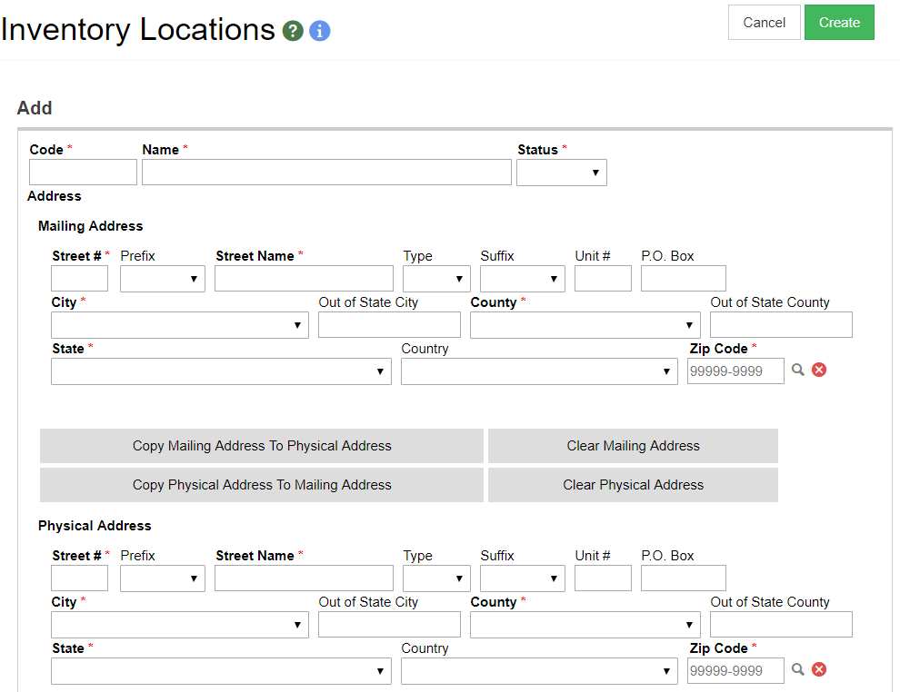
Inventory Location Setup
1
2
3
4
Codes must be unique.
Enter a Name for the inventory location.
Set Status to ACTIVE.
Enter a Mailing and Physical Address.

Slide 11
Inventory Location Setup (cont.)
1
2
Enter the name and contact information of the Administrator at the location.
Select if the location belongs to a clinic reporting doses administered via HL7 messaging.
Notes:
Do not select the Aggregate-Level reporting checkbox if the clinic(s) associated to the location use WebIZ to administer doses (direct entry users).

Slide 12
Inventory Location Setup (cont.)
2
1
Select a Clinic to associate to the location.
Click Delete to remove a clinic association.

Slide 13
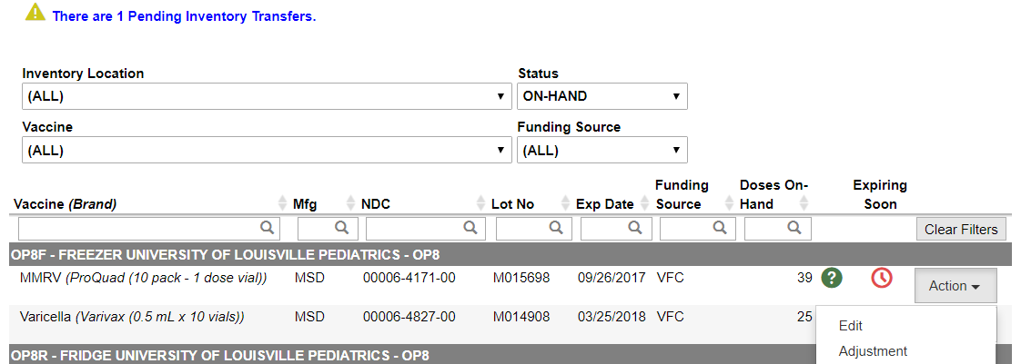
Inventory On-Hand
1
2
4
Use filters to find specific line items.
Use column filters to search for and/or sort line items.
View pending transfers.
Click Action to navigate to other inventory screens.

Slide 14
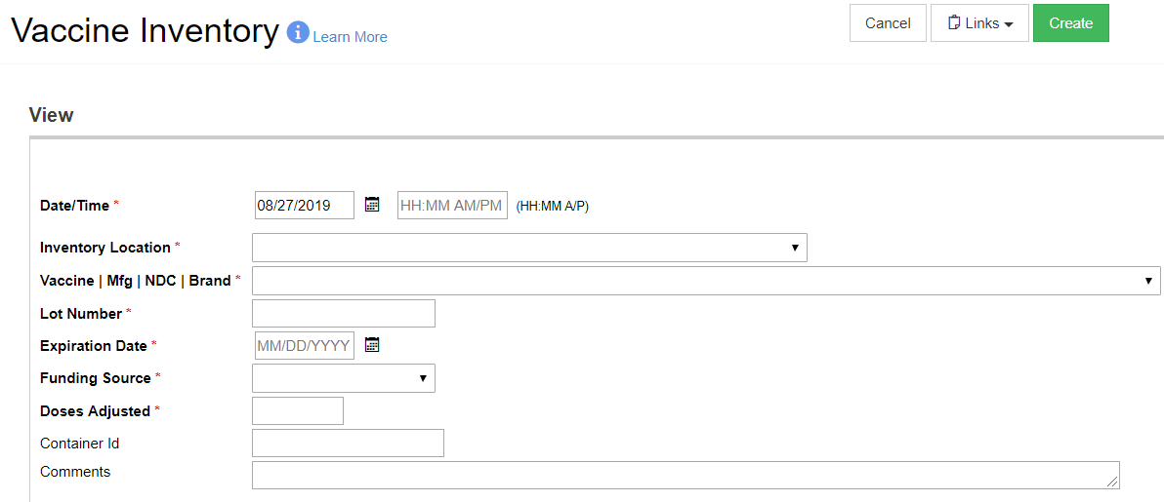
Add New Inventory
Complete required fields and click Create to add doses to inventory on-hand.
ShowMeVax checks for duplicate inventory line items automatically.

Slide 15
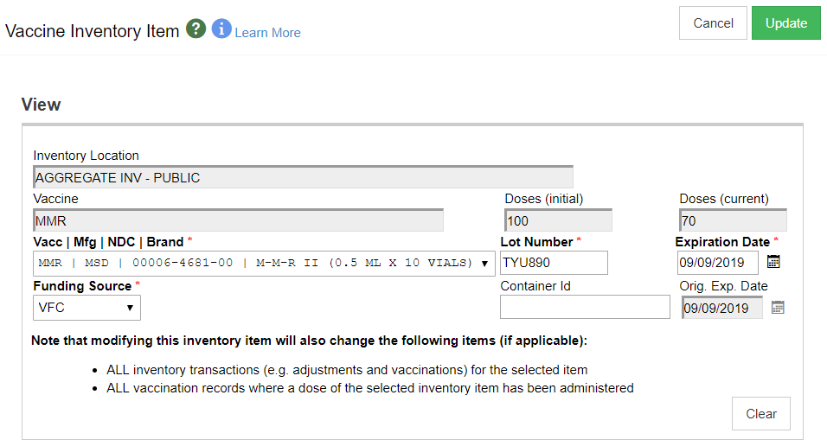
Edit Inventory
Update inventory line item Manufacturer, Lot Number, Expiration Date, and/or Funding Source.

Slide 16
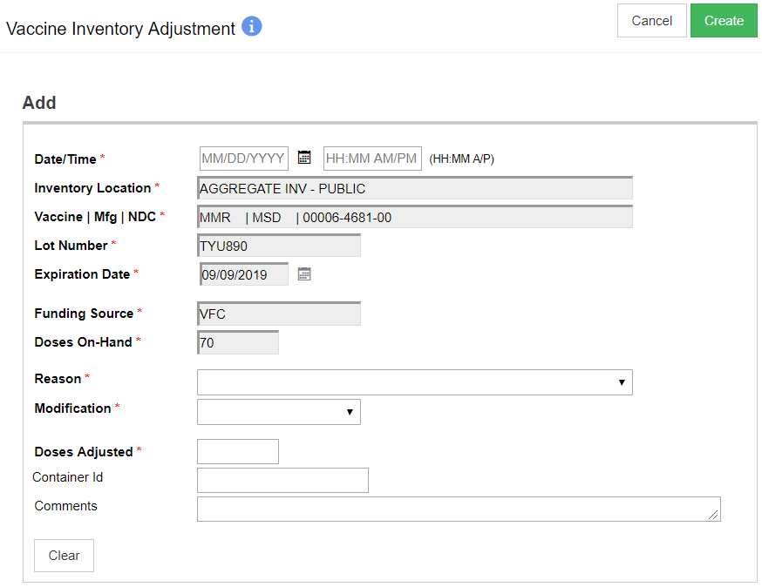
Inventory Adjustments
Add or remove doses from on-hand inventory for various reasons.
Code table values determine in which column adjustments appear on reconciliations.
Default Modification to ADD or SUBTRACT per Reason in the code tables.

Slide 17
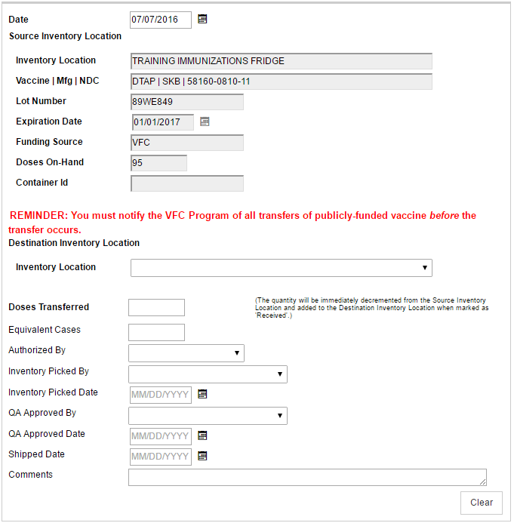
Transfer Inventory
Move doses from one inventory location to another inventory location within the provider or the registry.

Slide 18
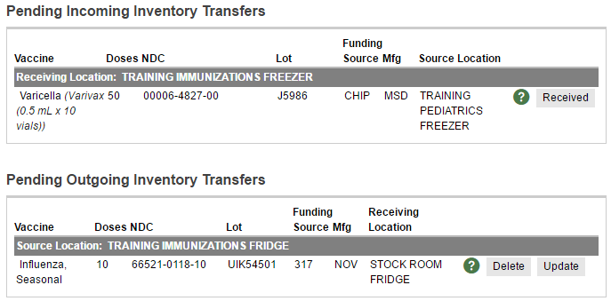
Pending Inventory Transfers
1
2
3
Mark incoming inventory transfer as Received.
Delete outgoing inventory transfer.
Update outgoing inventory transfer.

Slide 19
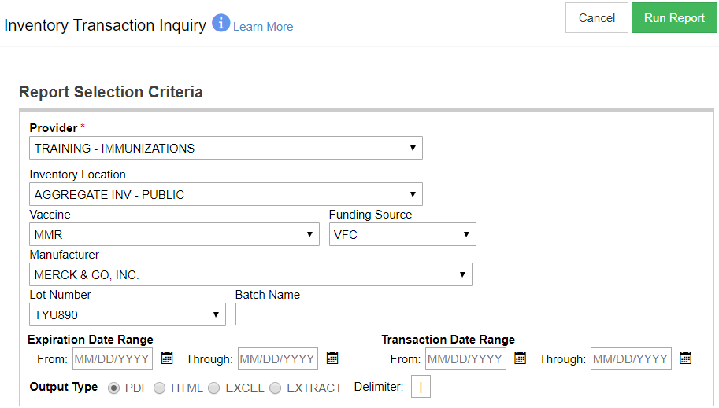
Inventory Inquiry Report
View all inventory transactions matching search criteria.

Slide 20
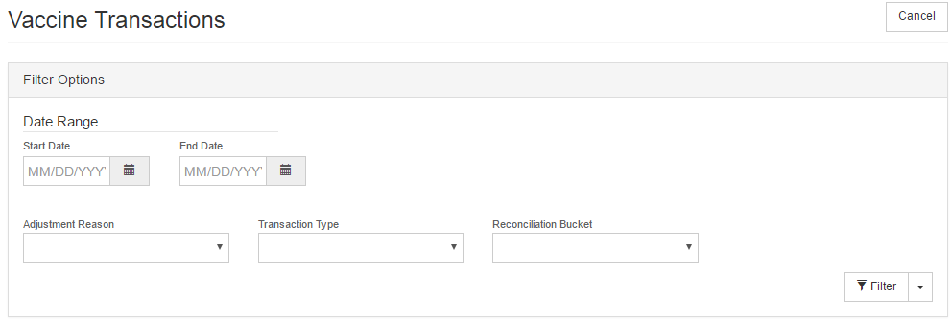
Reverse Wastage Transactions
Search for vaccine inventory adjustments matching search criteria.

Slide 21
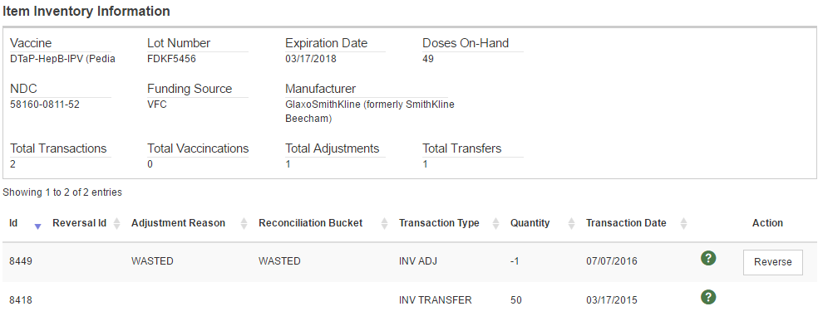
Reverse Wastage Transactions (cont.)
Click Reverse to “undo” an inventory adjustment transaction.

Slide 22
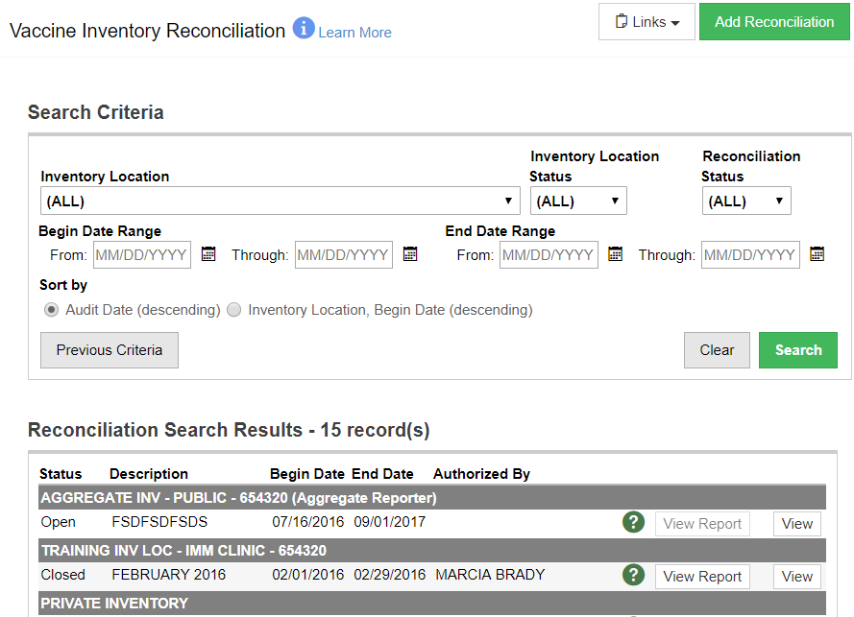
Inventory Reconciliation
1
Add a new reconciliation.
Search for existing reconciliations.
View existing reconciliations.
2
3

Slide 23
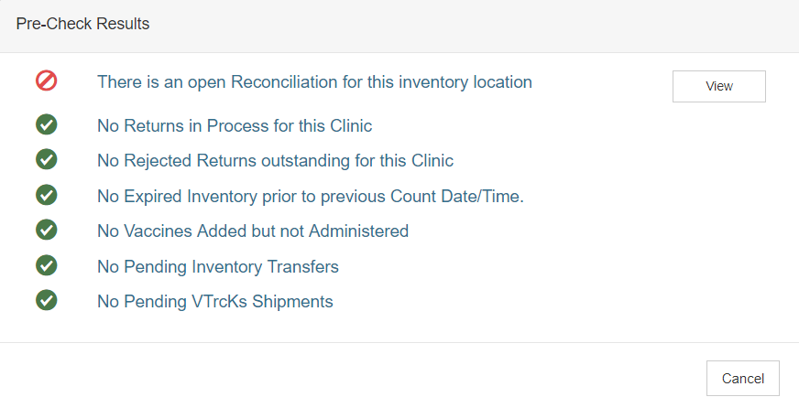
Add New Reconciliation
Before creating a new reconciliation, a pre-check will display any unresolved issues.
Click the View or Resolve button to address the issue.

Slide 24
Add New Reconciliation (cont.)
Last Count Date/Time defaults based on date and time of the last recent reconciliation.

Slide 25
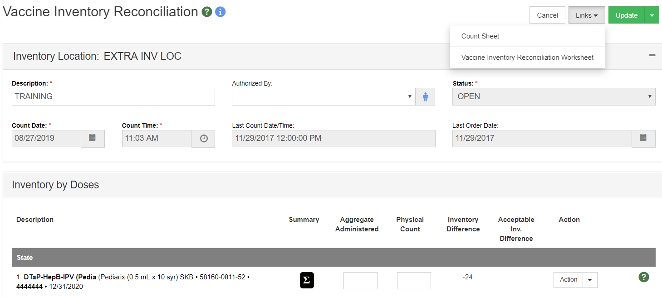
Reconcile Inventory
1
2
Print Count Sheet to complete physical inventory count.
Enter actual doses on-hand after physical count is complete.

Slide 26
Reconcile Inventory (cont.)
Hover over the sigma to view all transactions since last count and since item created.

Slide 27
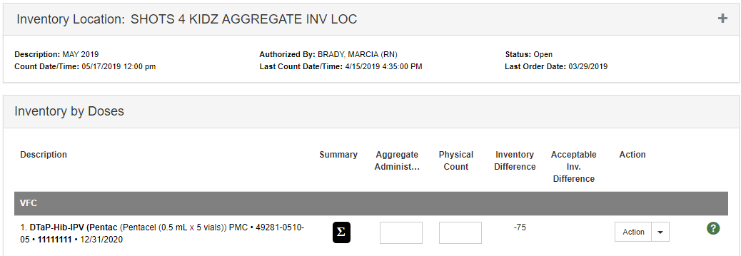
Reconcile Inventory (Aggregate)
Aggregate-level vaccine administered reporting locations must enter the total number of doses administered during the reconciliation period (or since the last count).

Slide 28
Reconciliation Best Practices
Complete physical counts at the specified time on the reconciliation count date.
Enter the actual inventory on-hand in the Physical Count field: Inventory Difference will not always be zero.
Make all inventory adjustments before the count date/time.
Adjust out expired inventory prior to beginning reconciliation.

Slide 29
Add Vaccine Order
3
1
2
Select the Clinic placing the order.
Select checkbox if placing a flu order.
Click Next to continue.
Note: Each clinic can only have one Normal and one Influenza vaccine order open (In Work or Rejected) at one time.
Notes:
A series of validations is triggered: clinic must be ACTIVE VTrckS status, user security function ALWAYS ALLOW VACCINE ORDER CREATE will override this validation. Clinic may not have any rejected returns open.

Slide 30
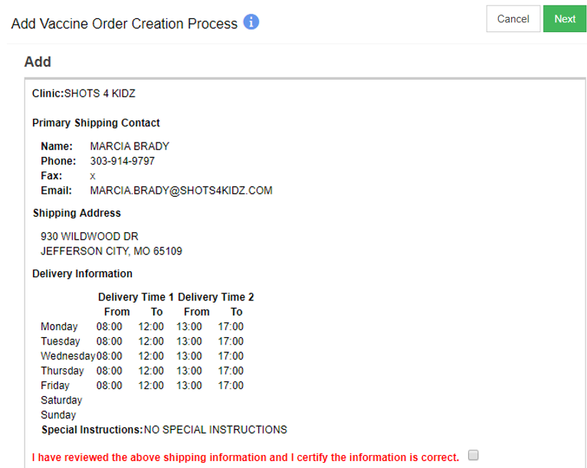
Add Vaccine Order (cont.)
2
Select checkbox to confirm information is correct.
Click Next to continue.
1
Notes:
If information needs to be updated, clinic must submit a change request or contact the VFC program.

Slide 31
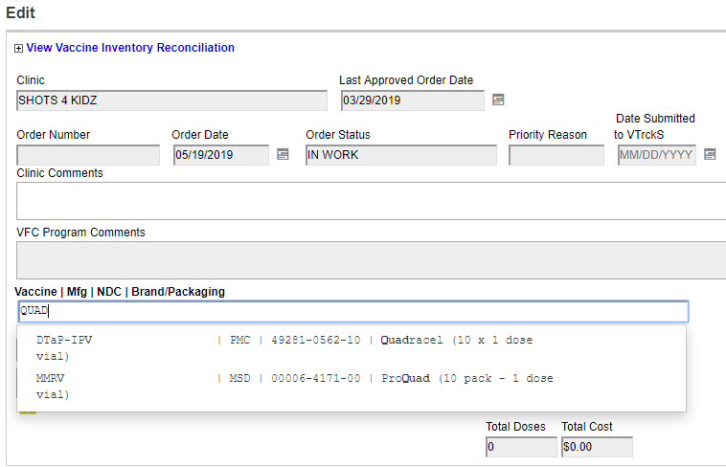
Add Vaccine Order (cont.)
1
2
Begin typing a vaccine, manufacturer, NDC, or brand.
Select a vaccine from the list.

Slide 32
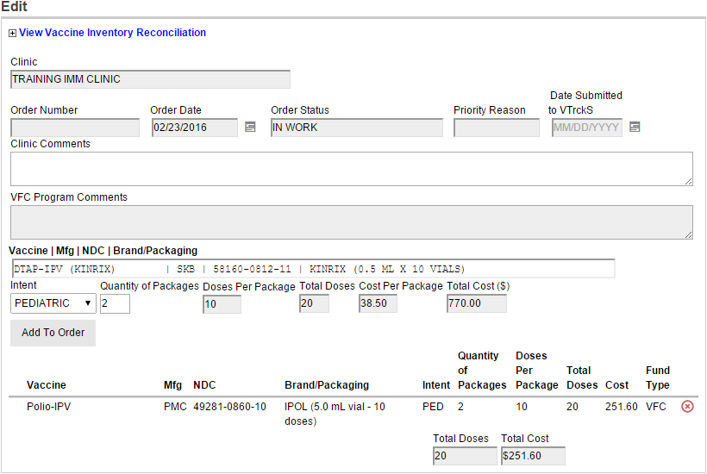
Add Vaccine Order (cont.)
Indicate Intent and Quantity of Packages.
Click Add to Order.
Enter any Comments.
3
1
2

Slide 33
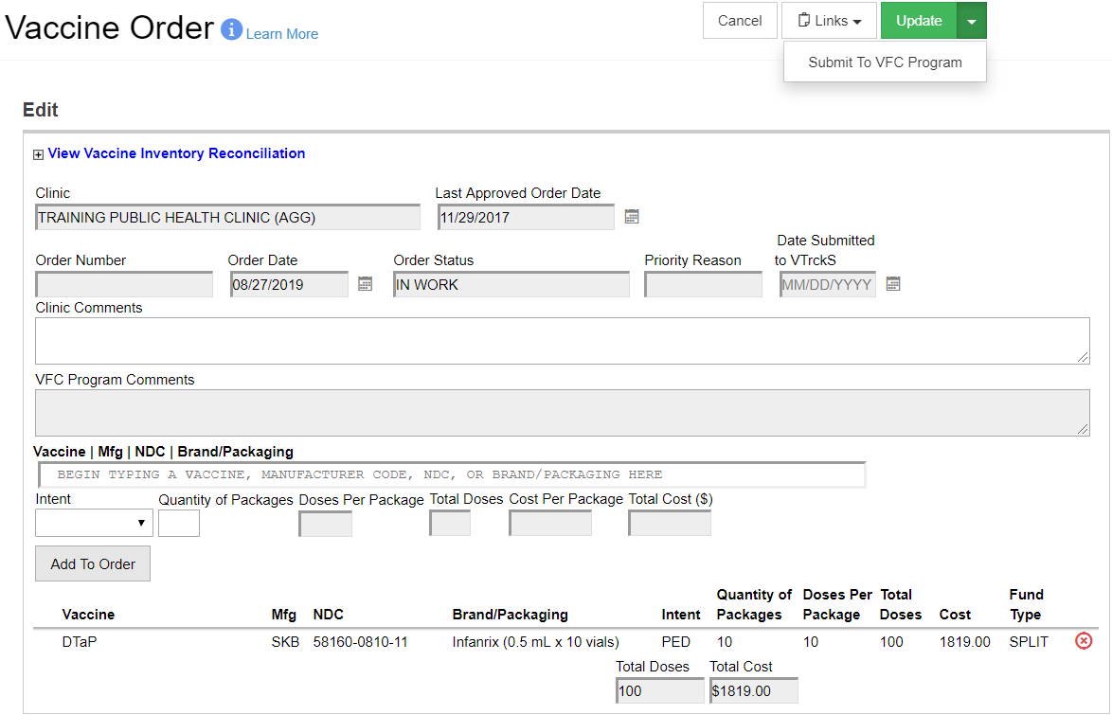
Add Vaccine Order (cont.)
1
Click arrow and select Submit to VFC Program.

Slide 34
Receive Vaccine Orders
1
2
3
Click to view shipment Details for the line item.
Click to Receive the line item into inventory on-hand.
Click to Dismiss the shipment, e.g., line item was never shipped and received.

Slide 35
Vaccine Returns
2
1
Select the Clinic returning vaccine.
Click Next to continue.

Slide 36
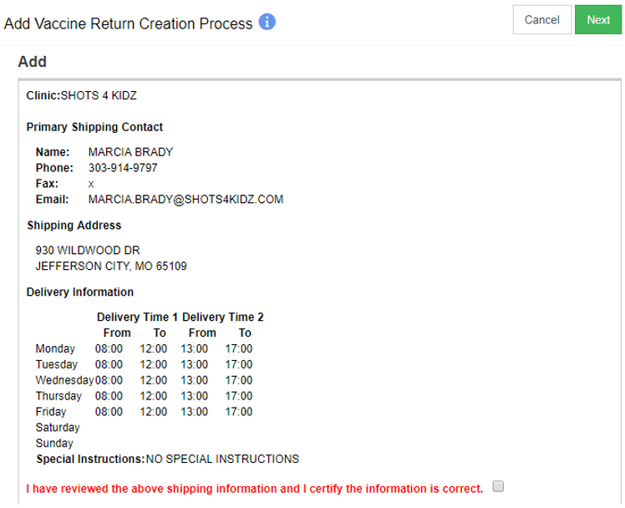
Vaccine Returns (cont.)
2
Select checkbox to confirm information is correct.
Click Next to continue.
1

Slide 37
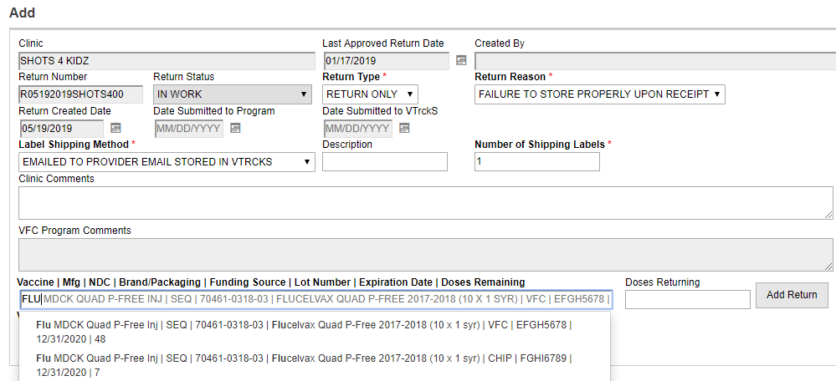
Vaccine Returns (cont.)
2
3
1
Begin typing a vaccine, manufacturer, NDC, and select a vaccine from inventory on-hand.
Enter the number of doses returned.
Click to add line item to return.

Slide 38
Vaccine Returns (cont.)
Doses are actually removed from on-hand inventory when a clinic submits a return to the VFC program

Slide 39
Electronic Decrementing
1
2
3
Enter Search Criteria.
Click to display additional options.
Click to Search for incoming inventory transactions matching criteria.

Slide 40
Electronic Decrementing (cont.)
Click to decrement inventory for all selected rows.

Slide 41
Vaccine Shipments
Transfer multiple inventory line items to a provider in one screen instead of creating individual transfers per line item
User must have MANAGE VACCINE SHIPMENTS security function

Slide 42
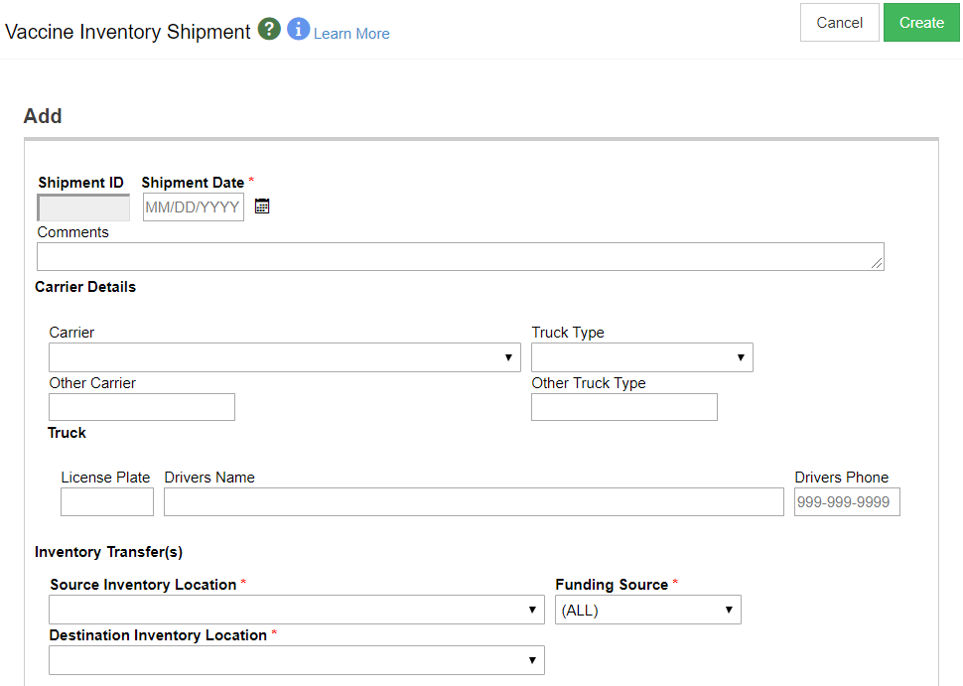
Vaccine Shipments (cont.)

Slide 43
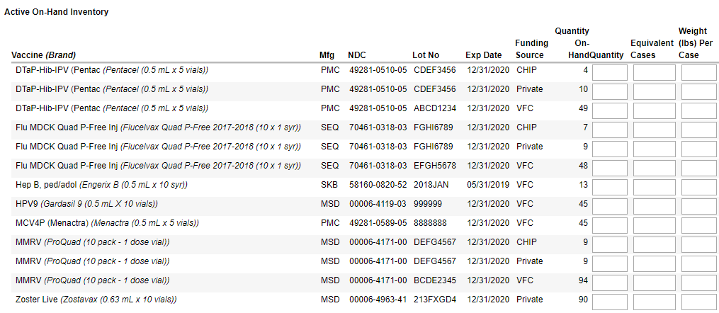
Vaccine Shipments (cont.)

Slide 44
Add Inventory
Hands-On Exercise

Slide 45
VTrckS Interface Module

Slide 46
Provider Master Data
Extract latest VFC clinic master data
Extract includes:
Address
Delivery Hours
Contact Information

Slide 47
Provider Ending Inventory
Extract latest VFC clinic doses on-hand
Extract includes:
NDC
Lot Number
Quantity
Expiration Date

Slide 48
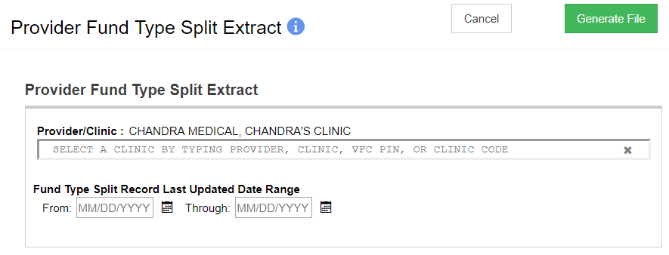
Provider Fund Type Split Extract
Extract latest fund type splits per NDC and intent
Extract includes:
VFC PIN
NDC and Intent
Funding source split

Slide 49
Provider Order Data
Search for orders submitted for approval
Modify orders as necessary
Approve or reject orders
Extract approved order data to send to VTrckS

Slide 50
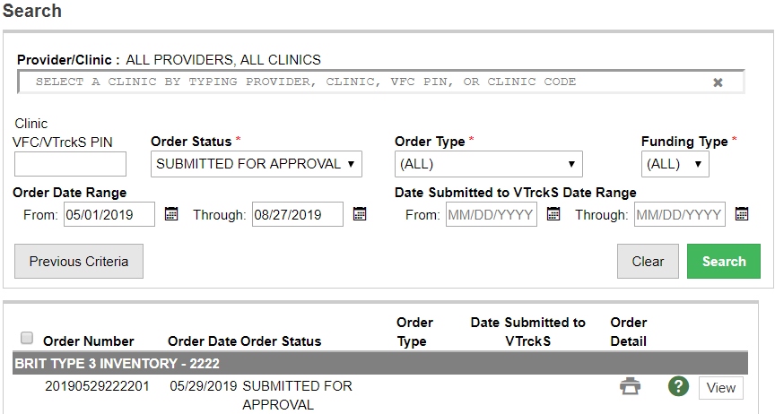
Search for Submitted Orders
Search for orders SUBMITTED FOR APPROVAL.
Click to View order details.
1
2

Slide 51
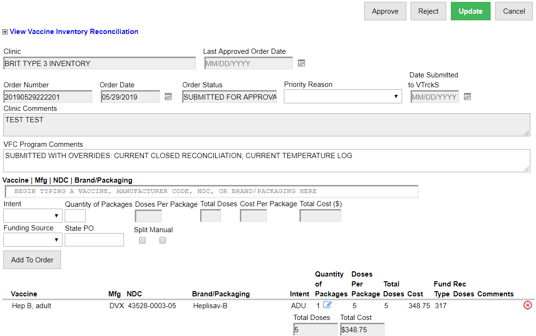
Modify / Approve / Reject Orders
1
2
Indicate a Priority Reason.
Add Comments.
Delete a line item.
3

Slide 52
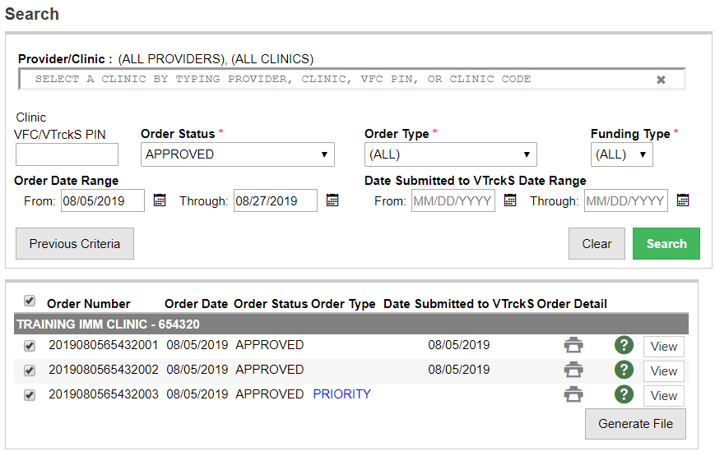
Extract Approved Order Data
Search for APPROVED orders.
Select the orders to include in the extract file. (Orders not yet submitted are automatically selected.)
Click to generate the extract file.
1
2
3

Slide 53
Provider Return Data
Search for returns submitted for approval
Approve or reject orders
Extract approved return data to send to VTrckS
The VFC Program cannot modify returns per line item, as this would change the clinic’s inventory on-hand without their knowledge.
Clinics must delete rejected returns before they are allowed to submit a new vaccine order.

Slide 54
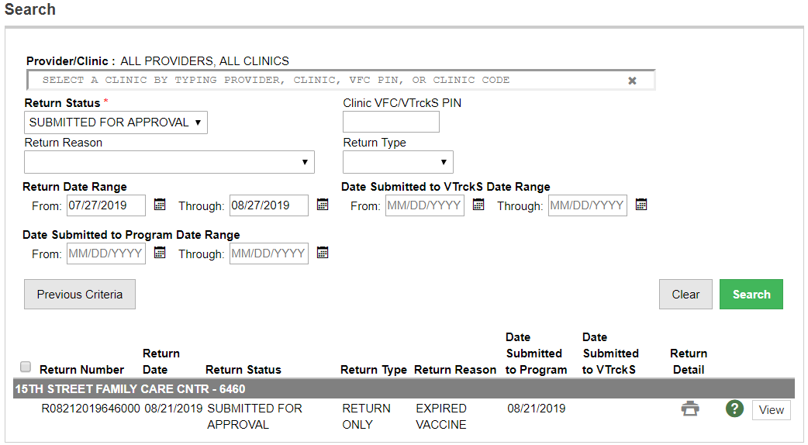
Search for Submitted Returns
Search for returns SUBMITTED FOR APPROVAL.
Click to View return details.
1
2

Slide 55
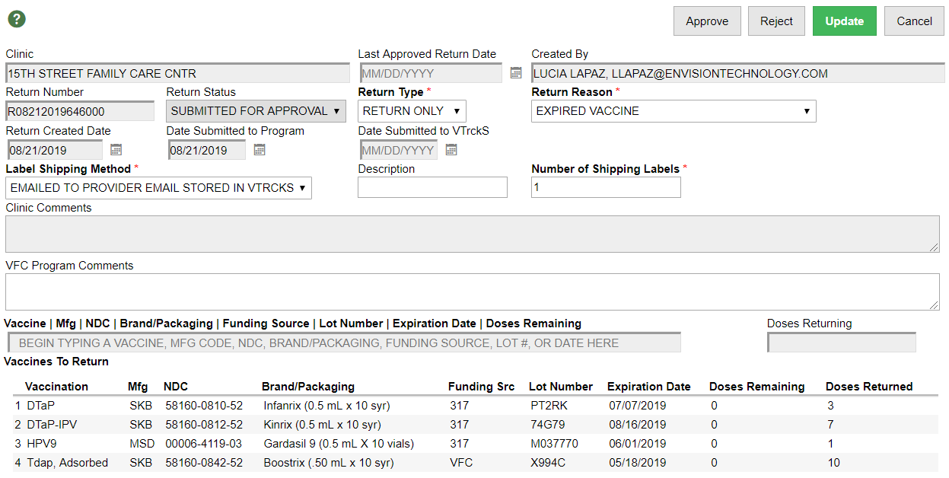
Approve / Reject Returns
2
1
Add Comments.
Approve or reject the return.

Slide 56
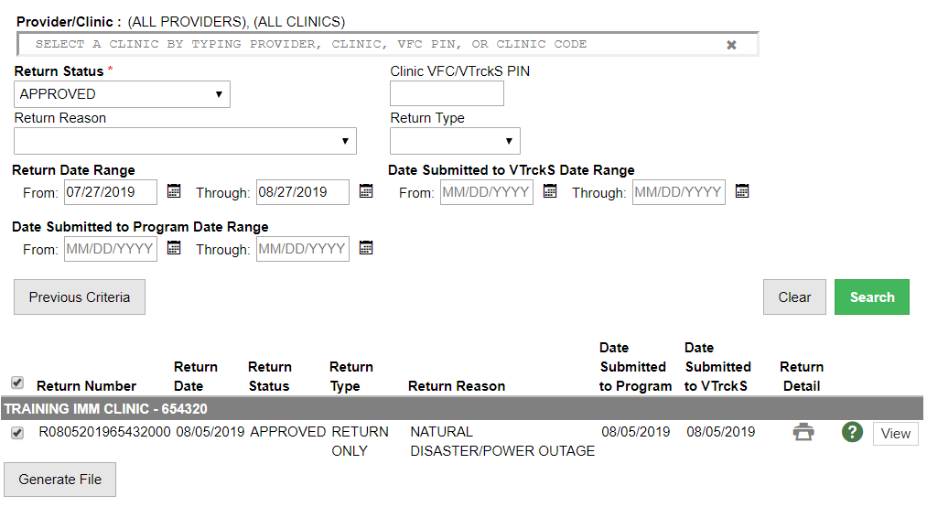
Extract Approved Return Data
Search for APPROVED returns.
Select the returns to include in the extract file. (Returns not yet submitted are automatically selected.)
Click to generate the extract file.
1
2
3

Slide 57
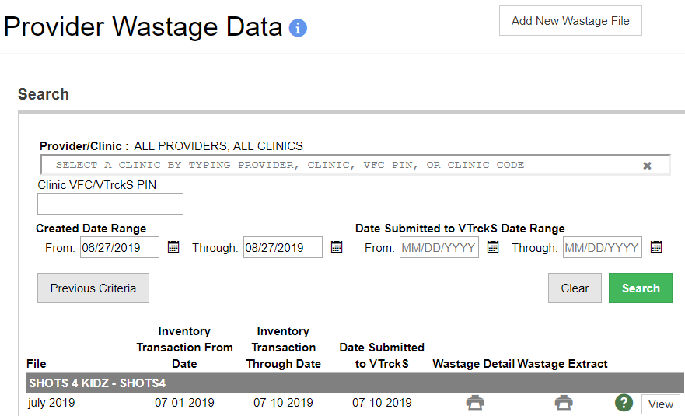
Provider Wastage Data
1
Click to Add a New Wastage File.
Click to download the wastage extract.
2

Slide 58
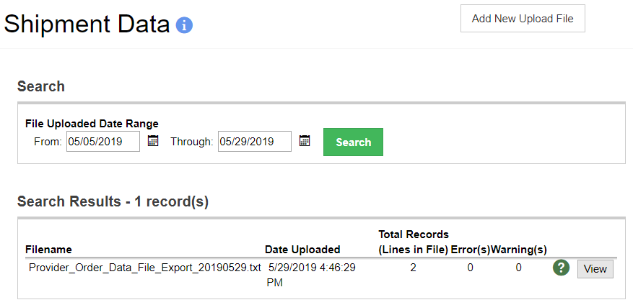
VTrckS Shipping Data
3
1
2
Search for previously uploaded shipment files.
View error(s) and warning(s) of a previously uploaded file.
Add a new VTrckS shipment file to WebIZ.

Slide 59
Upload VTrckS Shipment Data
2
1
Click to select the file to upload from your local computer.
Click to Import the shipment data into the registry.

Slide 60
Approve Vaccine Orders and Returns
Hands-On Exercise

